Slide 1
Global Gender and Environment Outlook (GGEO) -
An integrated assessment on the linkages between environment and gender
Jacqueline McGlade
Chief Scientist, UNEP
Director, Division of Early Warning and Assessment

Slide 2
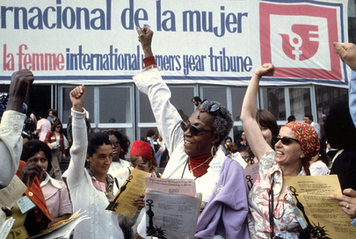
A brief overview of gender-environment background
“Women and Environment” issue: from Mexico, 1975 to Beijing Platform 1995
Women Rights, Gender Equality and Environmental Justice
Notes:
Rachal Carson: Silent Spring, 1962
Vandana Shiva and Bina Wagaral: wide range of conceptualization, from ecofeminism to feminist environmentalism
“women and environment” issue was brought into international attention first time at the First World Conference on Women, 1975 (Mexico City); and was recognized and formalized in Beijing Platform for Action (1985) of CEDAW.
Women’s Rights, Gender Equality and Environmental Justice (CEDAW, Rio Principles in 1992 – principle 20/and Agenda 21, and in SDGs/Post 2030 Development Agenda)

Slide 3
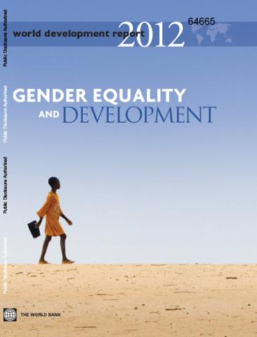
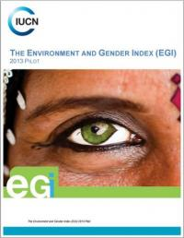
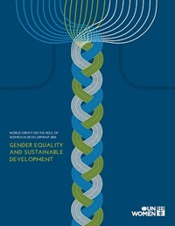
A brief overview of gender-environment background (continued)
30 years after Beijing Platform of Action, progress and improvement in growing the body of knowledge have been shown resulted to progress in gender mainstreaming in policy, and tool-sets for mainstreaming gender and working toward gender equality in development policies;
For example:
Notes:
UN Women: World survey on the role of Women in Development 2014: Gender equality and sustainable development
World Economic Forum: Global Gender Gap Report
IUCN: Environment and Gender Index
World Bank World’s Development Report in 2012: Gender Equality and Development

Slide 4
GGEO’s key assessment questions
Social forces
Ecological changes (gender-differentiated impacts)
Gender differences in responding to changes
Gender-differentiated perceptions of the future
Men and women as equal agents (actions & socio- economic factors)
Notes:
But specific work on gender & environment has lagged behind; the assumption that “the environment” is the province, primarily, of physical scientists has often meant that social science research into gender and gender inequality has not been well integrated into environmental assessments, and vice-versa
The Global Gender and Environment Outlook (GGEO) occupies a unique space at the intersection of environmental frameworks and ender-lens frameworks. The GGEO project will be the first large scale global environmental assessment to combine these approaches.

Slide 5
Approach
Analytical framework: Driver-Pressure-State-Impact-Response
Lens of Sustainable Development
Inclusive engagement through strategic partnerships

Slide 6
Data analysis approach
Drawing on a diverse mix of sources of information
Combining macro and micro data
Incorporating the social construction of knowledge
‘Lifting the roof off the household’

Slide 7
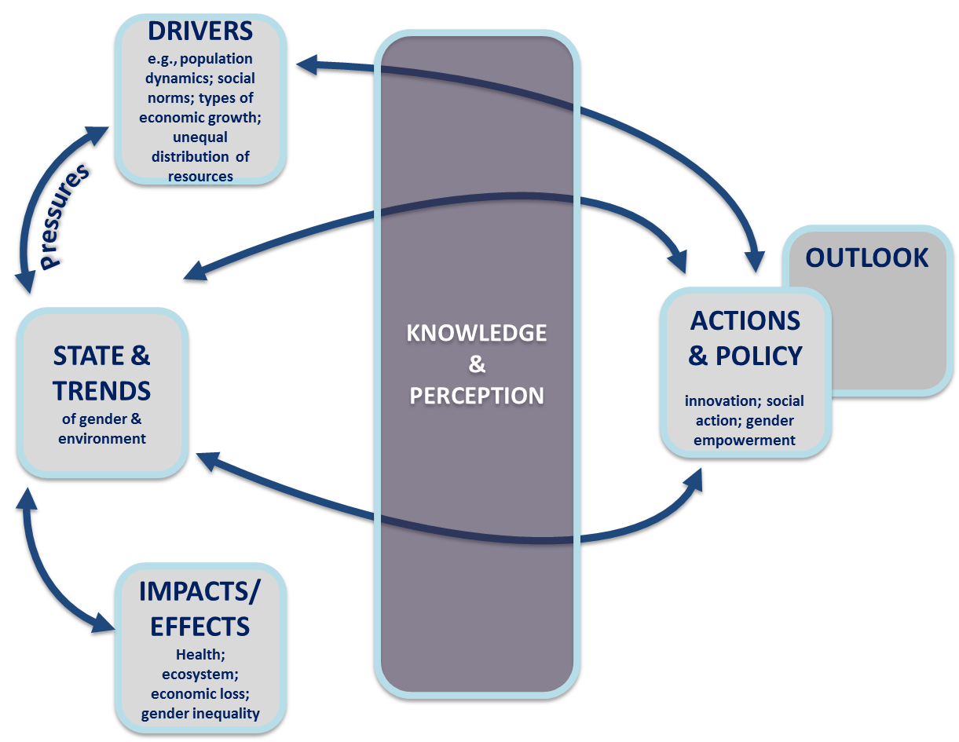
Analytical framework

Slide 8
GGEO outline
Chapter 1: Why gender and environment
Introduction
Why Gender and Environment?
What Are We Trying To Transform?
Shifting Dynamics
Looking Forward 15 Years – the SDGs and the 2030-Agenda for Sustainable Development

Slide 9
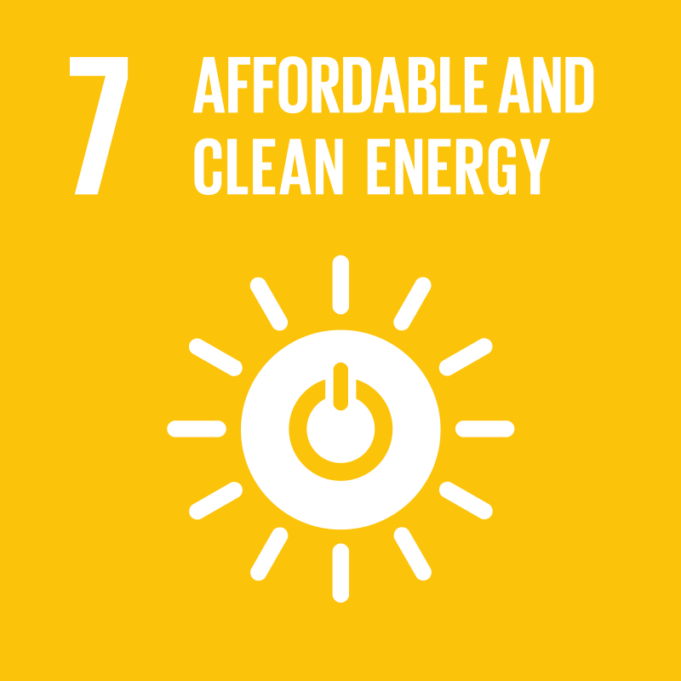
GGEO - The nexus between gender and environment
Chapter 2: The gender-environment nexus: state and trends
Food security
Water
Energy
SCP
Oceans
Forest
Notes:
Six thematic areas including:
Food security (Link to Goal 2)
Water and sanitation (Link to Goal 6)
Energy (Link to Goal 7)
Sustainable Consumption and Production (12)
Oceans/Fisheries (Goal 14)
Forest/Terrestrial ecosystem (Link to Goal 15)
Major cross-cutting issues including:
Human Health
Climate change
Disaster and Conflict
Biodiversity
Indigenous peoples

Slide 10
GGEO outline (continued)
Chapter 3: Outlook
A gender and environment outlook
Future pathways based on state and trends
The future we can have
Chapter 4: Policy framework
Implications for integrated resource management policies: mainstreaming gender
International enabling environment (e.g. MEAs and SDGs): enhancing gender sensitivity
Economic tools, methodologies and mechanisms to improve gender responses
Knowledge management and education: addressing the gaps and raising awareness

Slide 11
Climate change as a cross-cutting issue
Adaptation is gendered: climate-smart agriculture in food security, integrated water management and sanitation
Mitigation is gendered: reduced GHG in agriculture through soil conservation practices, clean energy, forest conservation, changing behavior and life-style through responsible consumption and production practices to reduce waste and GHGs
Financing for climate change: gender-responsive budgeting
Capacity building: the role of women in climate change adaptation and mitigation reflected through educating young generations regarding consumption and production choices and behaviours, but also on gender equality, the role of boys and girls etc.

Slide 12
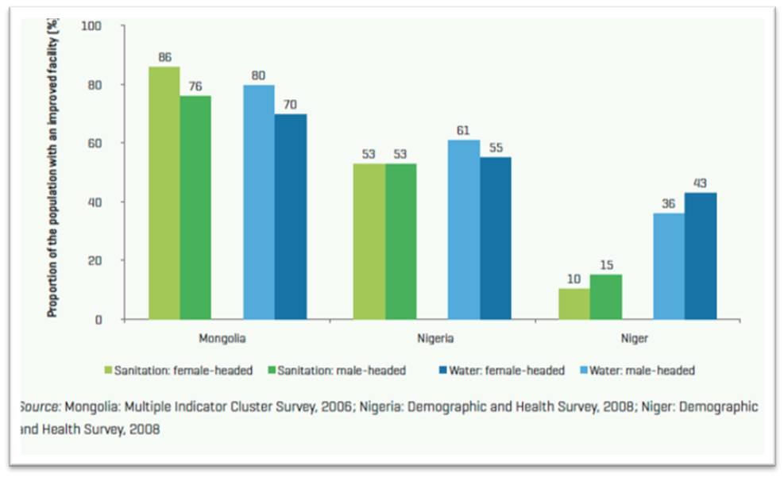
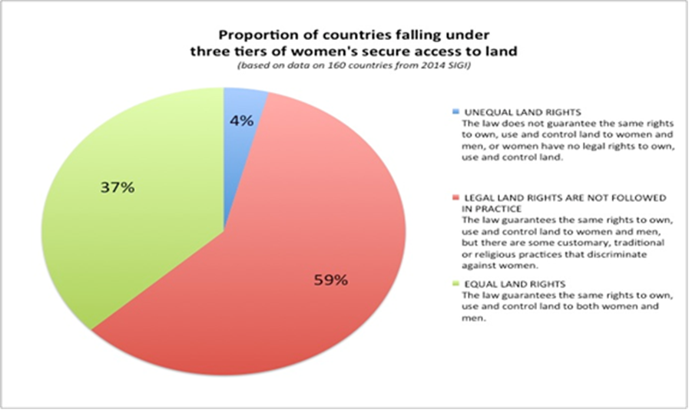
GGEO - The nexus between gender and environment
Women generally have less access to natural resources and other important resources for their livelihoods (training, technology, market information)
Access to Water and Sanitation facilities for men and women in Mongolia, Nigeria and Niger. Source: (UNICEF and WHO, 2012)

Slide 13
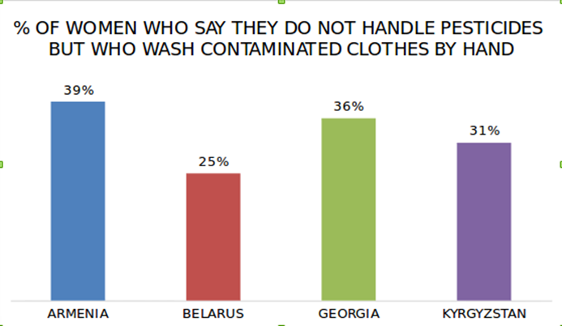
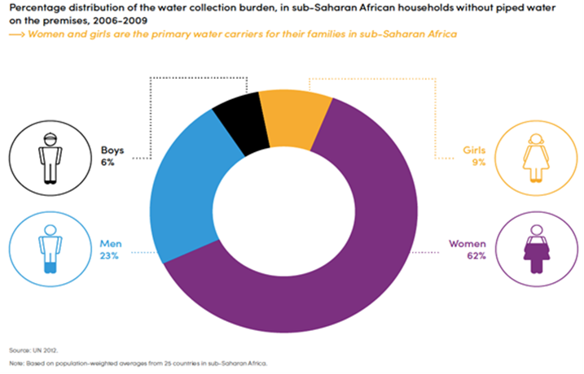
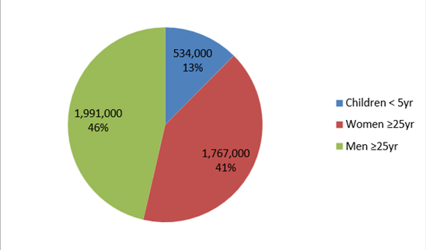
GGEO - The nexus between gender and environment
Men and women are affected differently by environmental pollution and degradation
Ratio of deaths attributable to household air pollution (HAP) in 2012. Source: WHO 2012
Source: (FAO and Pesticides Action Network UK (PAN UK), 2015)
Notes:
Examples:
Water carrying burden on women and girls . On average they carry a total 71% of the amount of water for the household. In case of drought or degraded water quality, this burden will increase and create higher impact on physical health (spine issues) of the water carrier.
Indoor air pollution also has serious impact on human health, particularly women and children. Please note that the number of men’s mortality is higher than women (46 % vs. 41%) is due to the combined effect with other diseases which might link to their daily habits including drinking, smoking etc.
The impacts of environmental pollutants such as pesticide also affect women through secondary contact as they bear responsibility for washing, cleaning.

Slide 14
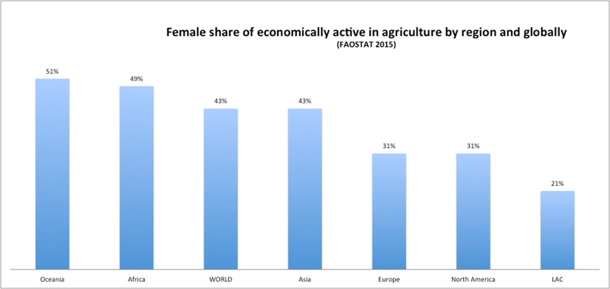
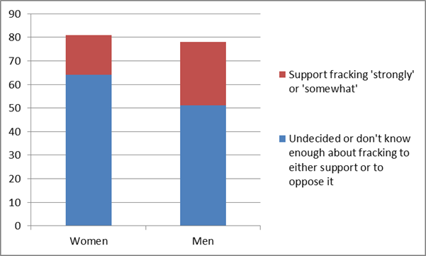
GGEO - The nexus between gender and environment
There are gender differences in the roles of women and men at both perceptual and practical levels in environmental conservation
Source (Yale University, 2012)
Notes:
Women generally occupy smaller proportion of work-force in most environment/natural resource related sectors, when it comes to the leadership of these sectors
Women’s labour and contribution is often not recognized in statistical data in many sectors such as agriculture, fisher, non-timber forest product management (not only unpaid care work)
Women’s role is becoming even more important, especially in rural areas due to male migration to urban areas for work; in many cases, this roles fall on elderly and youth who stayed behind.

Slide 15
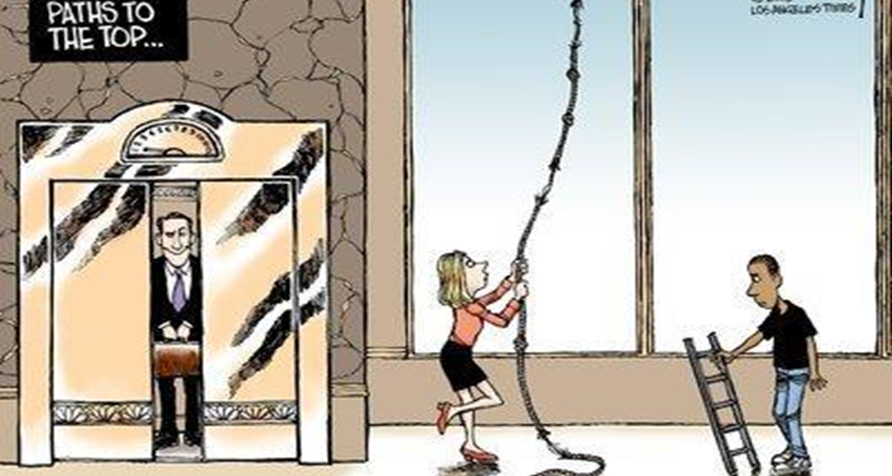
GGEO - The nexus between gender and environment
not just “state” and “impacts” that are gendered; drivers are gendered, too.
Notes:
Often the root cause of gender inequality rests in social structures including class, ethnic, age, values, social and cultural assumptions about gender identities, the value and power that a society attribute to men and women.
Large social and economic forces are reciprocally intertwined with gender inequality:
Pressure on economic (unsustainable) growth
Environmental change and degradation (climate change, biodiversity degradation)
Population growth
Migration
Conflict and security

Slide 16
Lack of gender-disaggregated data
One of the strongest messages from gender analysis on the environment is that the need for sex-disaggregated data is critical and urgent
In the absence of such data, all environmental analyses are inadequate and partial because establishing baselines, monitoring progress, and assessing outcomes are not viable
This is particularly important for the monitoring of the implementation of SDGs at country level

Slide 17
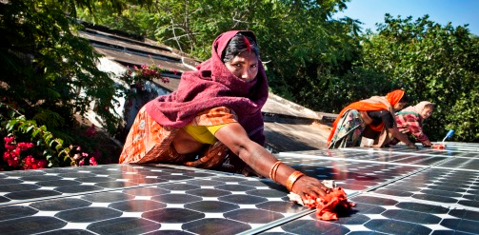
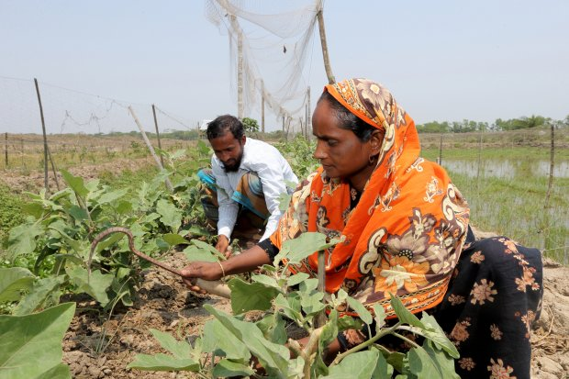
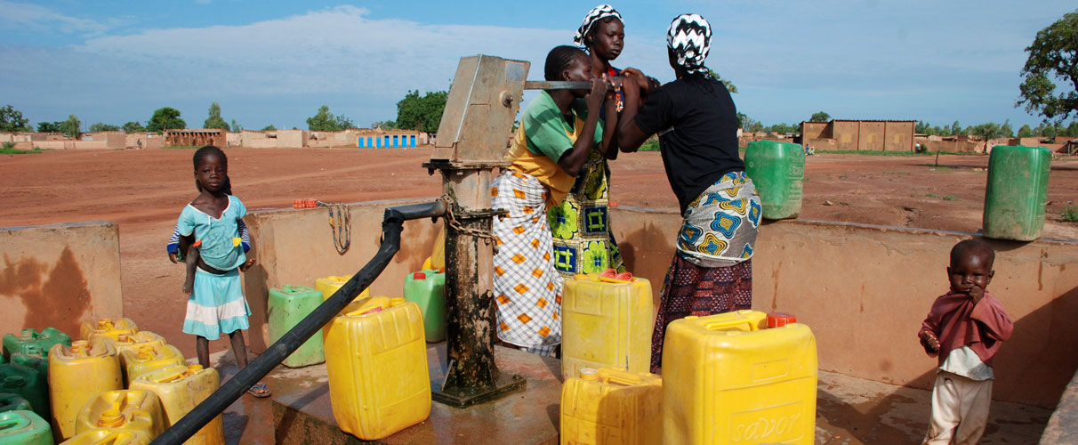
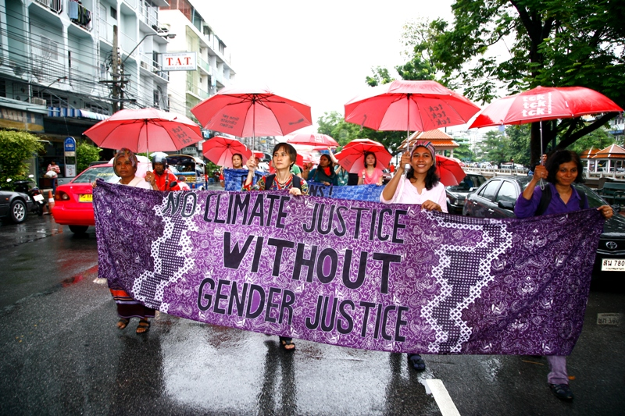
Gender & environmental transformational changes are inter-dependent
Notes:
Environmental sustainability and gender equality are intertwined (could say reverse: env unsustainability and gender inequality are intertwined)
Unequal power relations, manifested in settings from international policy institutions to households, shape how resources are distributed, controlled, used, and protected
As we recognize that “BAU” is not environmentally sustainable, shifts towards a more equitable future cannot be accomplished without changes in gender relations; gender inequality is embedded within BAU, and BAU includes large structures that increase both gender inequality as well as unsustainable development: militarism, corruption in governance, economic systems based on assumptions of endless resources for increasing production
For societies to adjust to the rapidly accelerating env changes we now confront, social systems must be flexible and resilient; they can’t be flexible, nimble, or resilient if the contributions of half the population are minimized, trivialized or outright excluded
In a future of gender equality, we double the human resources brought to bear on environmental solutions

Slide 18
Thank you for your attention

